Slide 1
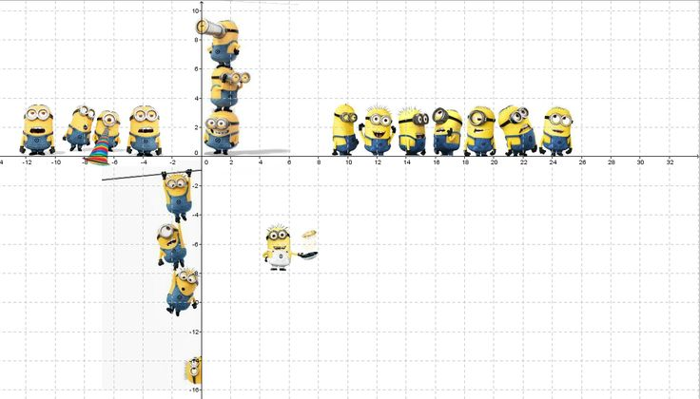
Number
Interactive Notebook
Your Name
Class 7.1 & 7.8
Mrs Riksman
Term 1 Semester 1
1

Slide 2
Contents
Glossary
Page
Date
Description
Word
Description
4-5
5/2
Whole numbers and place value

Slide 3
Title:
Date:
Tasks
Essential Question
Questions
Notes
Summary
4
5

Slide 4
Title: Whole Numbers and Place Value
Date: 6/2/15
EQ : Describe whole numbers and the place value system
Question:
Notes:
Whole numbers are those from 0,1,2,3,4..
Counting numbers are the same but exclude 0.
Sometimes whole numbers and counting numbers are called natural numbers.
Integers can be positive or negative and 0 is included.
Place Value:
The place in which you write a digit affects its value.
The larger place values are on the left.
Each place is 10 times as big as the one before it.
When there are 4 or more digits we separate each group of three with a comma.
When written in words you should use a hyphen in the numbers from twenty-one to ninety-nine
5

Slide 5
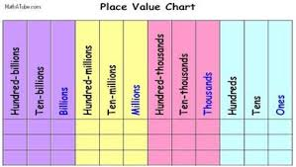

Slide 6
Tasks
Write the following numbers in words
609 - six hundred and nine
1039 -
70 104 -
504 860 -
4001 -
205 689 -
2. Write the following in numerals
Eight thousand, seven hundred and ninety six = 8796
Three million and eighty eight
Two thousand, three hundred and eighty five
Six thousand, nine hundred and seven
Four hundred and twenty thousand, eight hundred and thirty
Twelve million, nine hundred and one

Slide 7
Title: Expanded number form
Date: 9/2/15
EQ : Explain how to write a number in expanded form
Question:
Notes:
We can begin to expand numbers by identifying what position the number is in then multiplying it by this number.
In the above example the 3 is in the Thousands column so in expanded form this is written as (3 x 1000)
If we were to write the remaining numbers in the above example we would end up with the following expanded or extended form.
(3 x 1000) + (2 x 100) + (1 x 10) + (7 x 1)
We can also change the place values over 10 to the powers of 10 seen in the third row.
(3 x 10³) + (2 x 10²) + (1 x 10) + (7 x 1)
3 | 2 | 1 | 7
Thousands | Hundreds | Tens | Ones
10³ | 10² | 10 | 1
7
5

Slide 8
Tasks continued
1. Write the value of the underlined number in the following:
67 453 = (7 x 1000)
2 756 809
432 032
6 752
311 513
13 562 913
935
2 001
678 888
2. Write the following in expanded form then complete the worksheet
57 389 = (5 x 10⁴) + (7 x 10³) + (3 x 10²) + (8 x 10) + (9 x 1)
532
9 876
10 617
2 089

Slide 9
Notes Review
24, 7 ,30
Date
Title
Essential question
Notes complete
Notes complete with colour and diagrams
Questions completed
Contents page filed in
Formula page filled in

Slide 10
Homework
Review your notes and write a summary answering the essential question.

